Slide 1

A Voice-Controlled Web Navigation System
Supervised by - Dr. Shamim Al Mamun, Professor
Presented by – Sudipta Sarker
ID – 212126, PMIT, JU

Slide 2

Motivation
Problem: Traditional browsing needs keyboard/mouse limits accessibility.
Need: Hands-free web navigation

Slide 3
Objectives
Enable voice-based control of browser
Implement core browsing features: search, tab, scroll, media, forms
Evaluate performance (response time, accuracy)

Slide 4
Proposed System Architecture
User
Voice Capture
Speeh Recogniton
Intent Processing
Action Execution
Browser Feedback

Slide 5
Link Interact
Read Aloud
Media Control
Browser Control
Tab Manage-ment
Inline Search
Form Fill Up
Input Processing
Implemented
Features

Slide 6
Implemented Features (Continue…)
Voice Input : Interpret text from captured voice input
Media Control: Hands free media interaction(play,pause,mute,unmute…)
Tab Management: Switch between tabs, open/close tab
Browse Control: Set page view by scroll up/down, zoom in/out/reset.
Link Interaction: Display available links and click them by title/number.
Read Aloud: Narrates the selected text with highlighted sentence.
Form Fill-Up: Filling up form fields through voice interaction.
Inline Search: Perform search without opening a new tab(Google/Youtube).

Slide 7
Implementation (Technology)
Technology | Purpose / How It Was Used
JavaScript (ES5) | Used to implement core logic for capturing voice, parsing commands, executing browser actions
Chrome Extension APIs | Used for tab management, content scripts, and browser interaction
Web Speech API | Converts voice input to text and detects language
JSON | Stores commands and mappings to the corresponding actions
HTML / CSS | Used for designing Floating mic button and UI for feedback

Slide 8
Implementation: Example Workflow (Link Interaction)
User says “show links” : All visible links are numbered in current web page“
User can click links by the badge number or title.
Selected link is highlighted with yellow color before click event is dispatched.

Slide 9
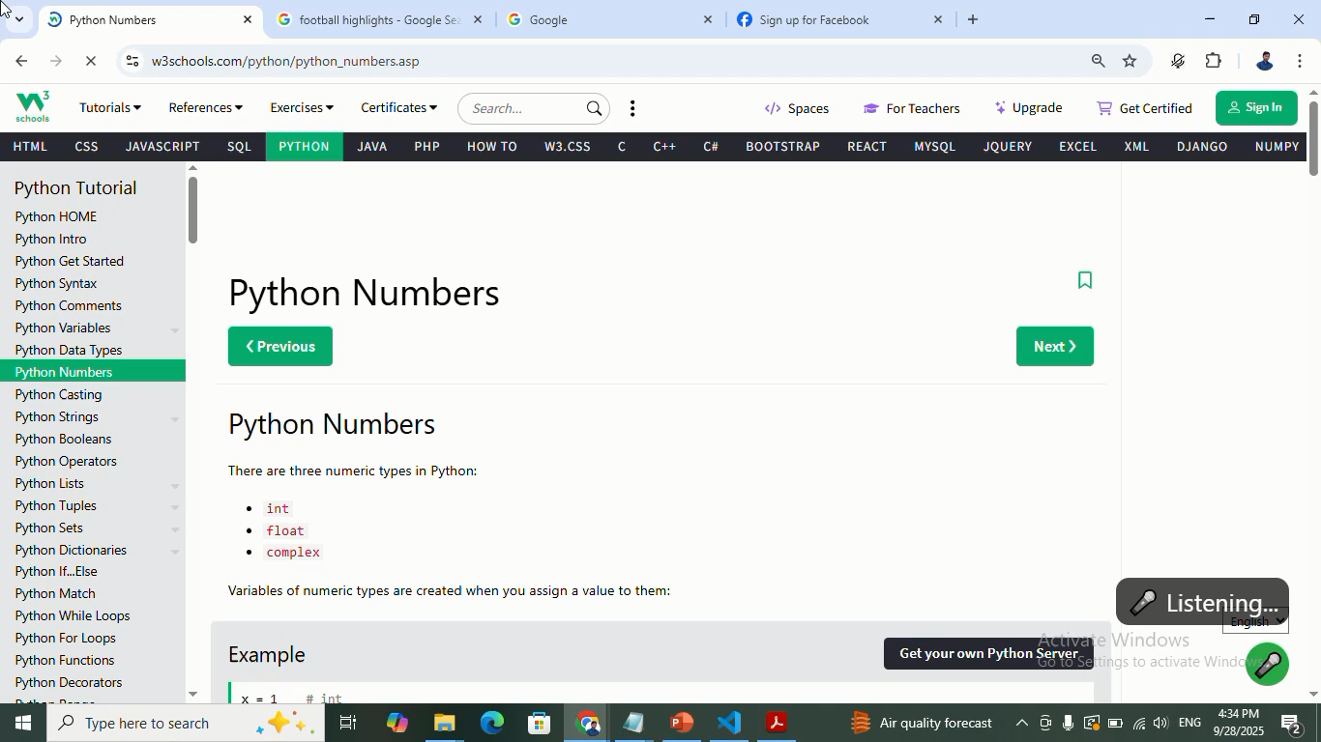
Link Interaction – Continue…

Slide 10
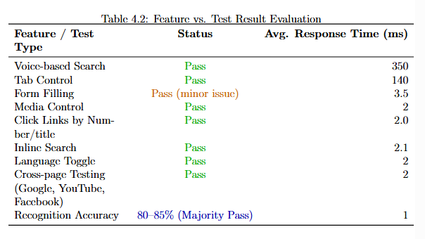
Testing & Evaluation

Slide 11
Limitations
Speech accuracy depends on environment.
Limited to Chrome browser.
Multi-language recognition still improving.

Slide 12
Future Work
Add AI-based command understanding
Add custom commands.
Add support for more browsers.
Add integration Other Features

Slide 13
Conclusion
Proposed system is efficient, accessible, low-latency
Demonstrated hands-free browsing successfully
Ready for future enhancement

Slide 14
Thank You

